Slide 1

基于MindSpore的Falcon大模型迁移与性能研究
1bit quantization
Week 18
曾子瑄
2024.03.16
Notes:
照片为学生拍摄的礼堂

Slide 2
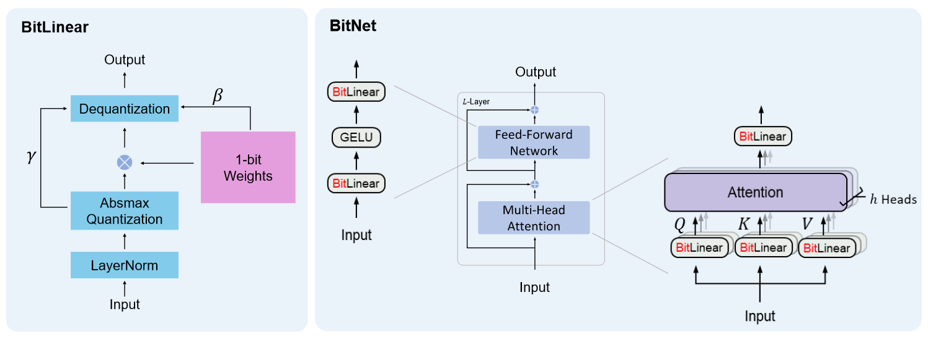

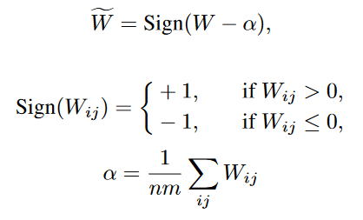
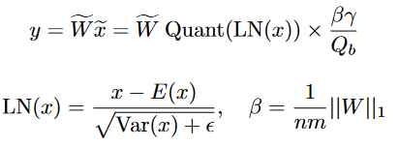
Quantization algorithm
BitNet

Slide 3
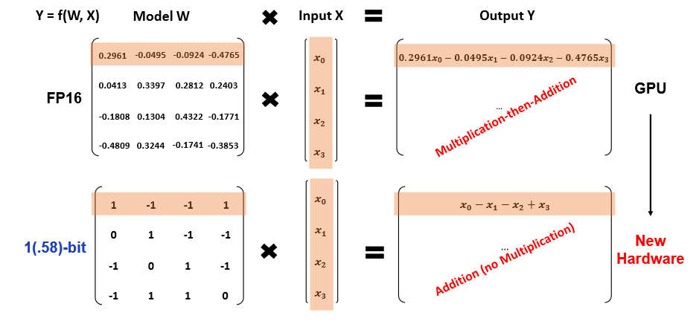
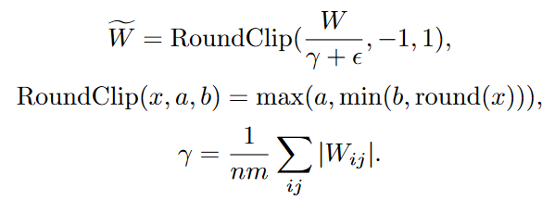
Quantization algorithm
sparse optimization?
Quantization Function
LLaMA-alike Components
BitNet b1.58
BitNet

Slide 4
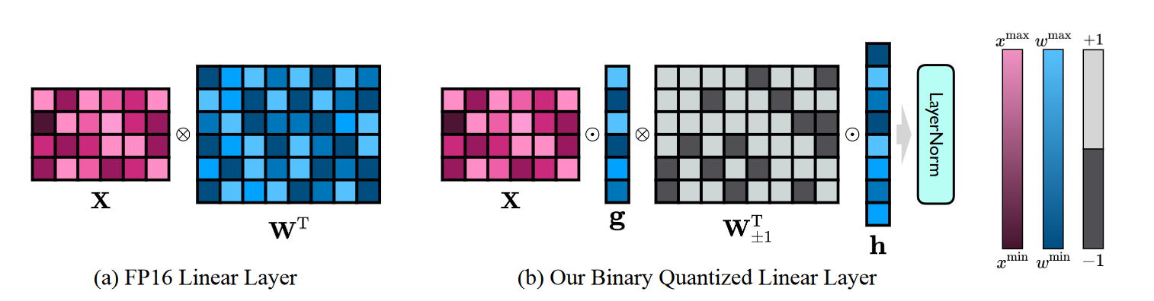
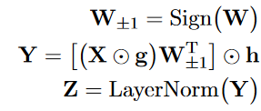
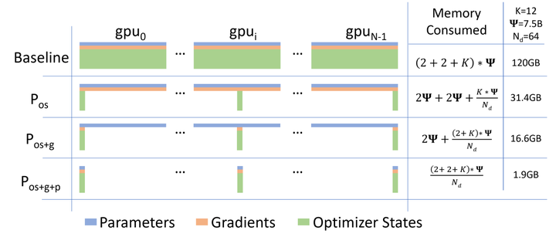
Quantization algorithm
SVID
Knowledge Transfer

Slide 5
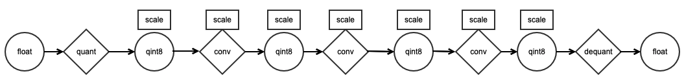
Problem
FP16 Weight
FP16 Activation
INT1 Weight
INT8 Activation
INT1 Weight
INT8 Activation
LLMs on Edge and Mobile
New Hardware for 1-bit LLMs
Multiplication(FP16)
Dequantize
Multiplication(INT1)
FP16
FP16
INT8
architecture
ISA
Operator
AMP
……
Accumulation(FP16)
Multiplication(FP16)
Accumulation(INT8)
FP16
INT8
Accumulation(FP16)
Dequantize
FP16
Requantize
FPGA+custom architecture
GPU/CPU+custom operator
FP16 Activation
W1A8 Activation
W1A8 Activation

Slide 6
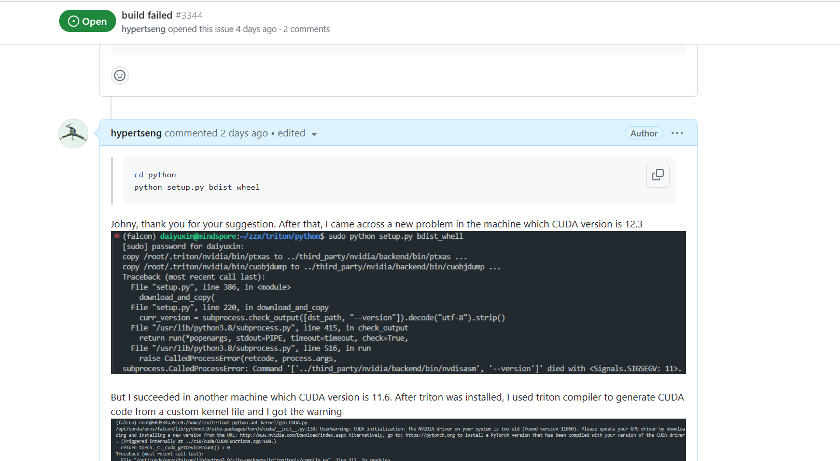
FlashAttention Support

Slide 7


